Slide 1
University of Houston Clear Lake
Computer Applications UHCL Conference
2D & 3D Image Compression with Skeletonization
Dr. Liwen Shih
Sam Tran

Slide 2
2D & 3D Image Compression with Skeletonization
Abstract
Skeletonization helps an object image easier to be read/used in object recognition. Skeletonization is also an important compression tool. Binary images is compressed/skeletonized, transmitted, and then reconstructed/decompressed at the destination. Animation uses skeletonization to perform movements first and then reconstructs the object. The demands of skeletonizaton appear in many areas. However, existing skeletonization techniques suffer connectivity loss, and are mostly sensitive to noise, very time consuming, or restricted to specific 3D models. This presentation shows an approach to overcome the weaknesses above as well as some practical results applied on rocks to help scientists evaluate oil/water/gas stream through the rocks.
Acknowledgement: Partially sponsored by TX HECB ARP/ATP

Slide 3
2D & 3D Image Compression with Skeletonization
Index
Introduction
Previous works
Our approach
Implementation
Some practical results
Limitations
Conclusion
References

Slide 4
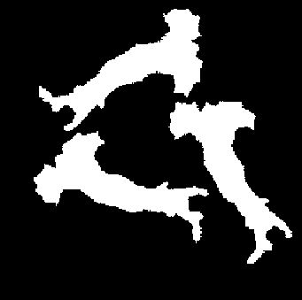
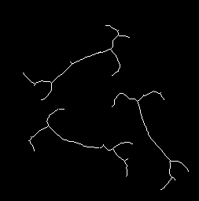
2D & 3D Image Compression with Skeletonization
I. Introduction
Definition:
The skeleton is an object reduction.
Properties:
  Geometrically centered within the object boundary .
  Having the same connectivity with the object.
  Topology remain constant, and one pixel of thinning.
Object
Skeleton

Slide 5
2D & 3D Image Compression with Skeletonization
II. Previous works – Boundary peeling/Erosion
Description
    Operate on the boundary from outside to inside.
    Test each boundary voxel to see if it is removable.
    Peel off layer by layer.
Advantages
    Connectivity preservation.
Disadvantages
    Time consume
    Noise sensitive
    Hardly to extend to 3D

Slide 6
2D & 3D Image Compression with Skeletonization
II. Previous works – Distance Transformation based on Voronoi Diagram
Description
    Based on Voronoi diagram concept.
    Suitable for polygonal defined object
Advantages
    Accuracy and good in connectivity preservation.
Disadvantages
    Complicated and slow
    Noise sensitive
    Hardly to extend to 3D

Slide 7
2D & 3D Image Compression with Skeletonization
III. Our approach - Euclidean Distance Transformation
Description
    Find the center pixels using Euclidean distance.
    Connect all center pixel clusters to form skeleton.
Advantages
    Fast
    Noise insensitive
    Simple, extendable to 3D.
Disadvantages
    Lost of connectivity.

Slide 8
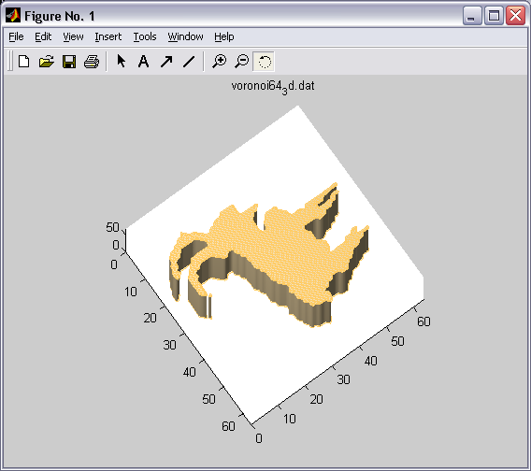
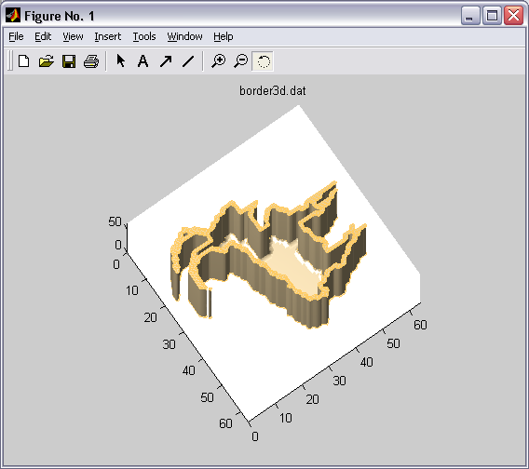
2D & 3D Image Compression with Skeletonization
IV. Implementation
  Find the center pixels using Euclidean distance.
  i. Border detection:
Object
Border
Note: The border figure above was peeled out the top layer.

Slide 9
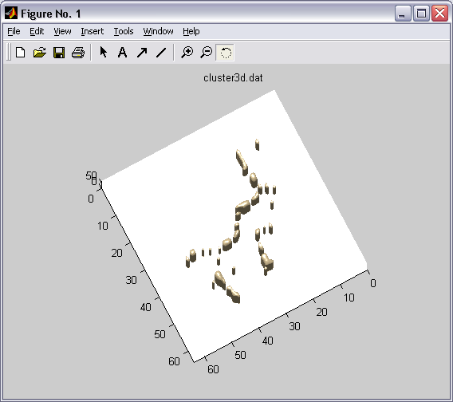
2D & 3D Image Compression with Skeletonization
IV. Implementation
  Find the center pixels using Euclidean distance.
  ii. Pick out central pixels
Border
Central Pixels
Note: The border figure above was peeled out the top layer.

Slide 10
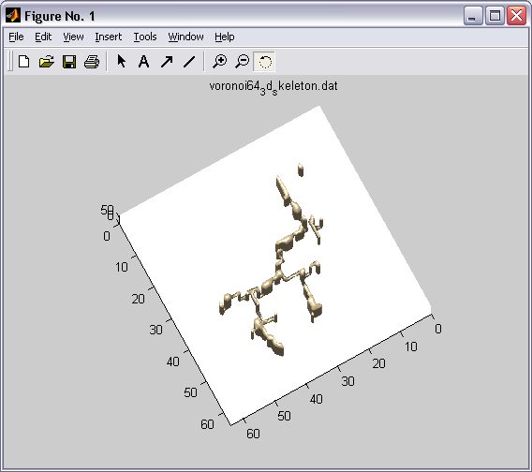
2D & 3D Image Compression with Skeletonization
IV. Implementation
  2. Connect all center pixel clusters to form skeleton
  i. Recognize the clusters:
      Scan all central pixels.
      For each unassigned central pixel, check all its neighbors if any neighbor is a central pixel. If yes, mark it the same cluster with the pixel. Repeat this step for the neighbors until there is no central pixel neighbor.
  ii. Connect the clusters together:
      Pick a random cluster, shell it until it touches any another.
      Merge the two clusters.
      Repeat until there is only one cluster remain.
Clusters
Connected clusters

Slide 11
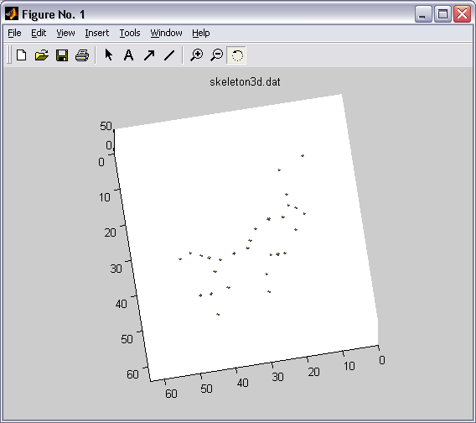
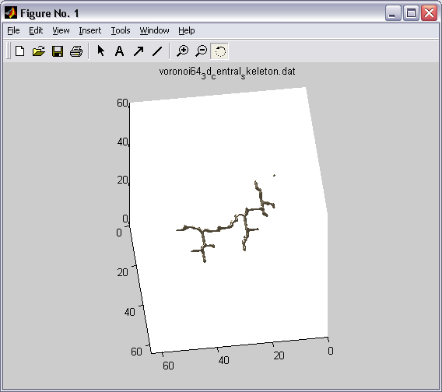
2D & 3D Image Compression with Skeletonization
IV. Implementation
  3. Trimming
  The skeleton is one pixel of thinning, so, it needs to be trimmed.
  Our solution:
      Each cluster selects only one pixel that stays very middle of the cluster.
      Connect these middle pixels to form skeleton.
      This solution contributes to limitations of our algorithm that will be considered detail in VI.
Clusters
Middle pixels of the clusters
Connected middle pixels

Slide 12
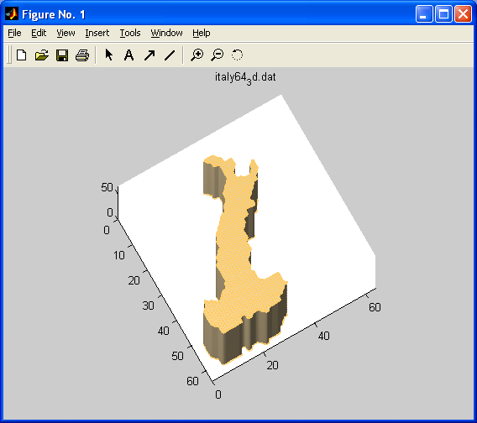
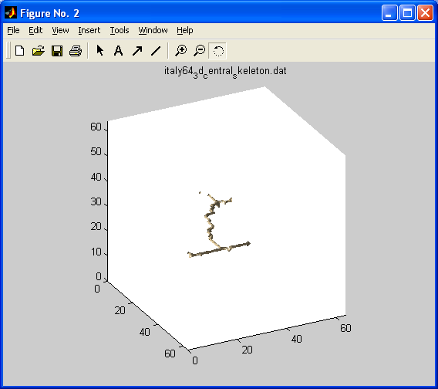
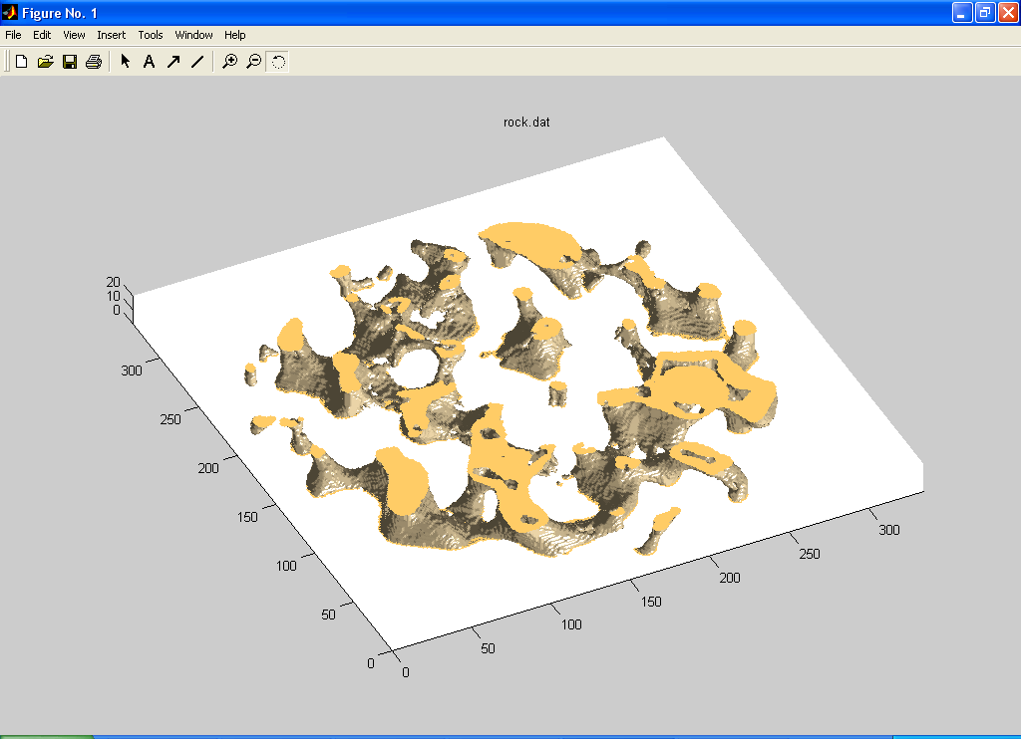
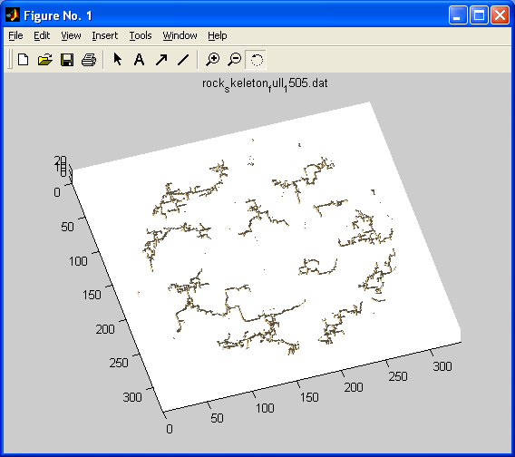
2D & 3D Image Compression with Skeletonization
V. Some practical results
Italy map
Italy map skeleton
Rock sample
Rock sample skeleton

Slide 13
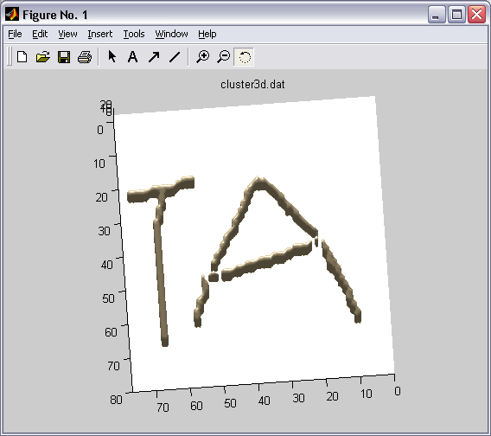
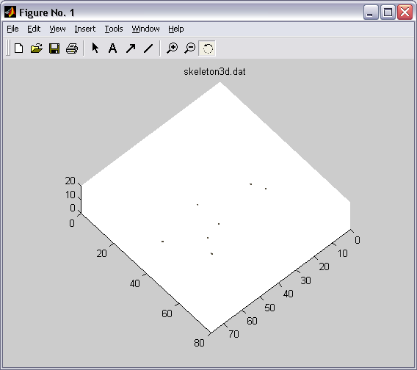
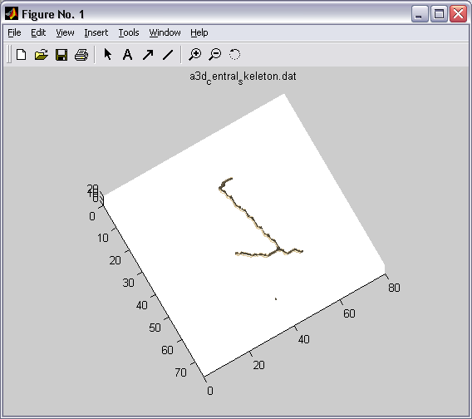
2D & 3D Image Compression with Skeletonization
VI. Limitations
Our solution overcomes the loss connectivity of the Euclidean Distance Transformation and ensure one pixel thinning of the skeleton. However, the using of middle pixel leads to losing information of a cluster. Especially, when the cluster is big as in the following example:
Big cluster Sample
Middle pixel cannot express whole cluster
Lost shape conservation

Slide 14
2D & 3D Image Compression with Skeletonization
VII. Conclusion
The algorithm is fast and gives good results for objects having small clusters as the rock sample. However, it need to be improved the trimming limitation (as said above) to get better results.

Slide 15
2D & 3D Image Compression with Skeletonization
VIII. References
Y. Zhou, A. Kaufman, and A.W. Toga, “3D skeleton and Centerline Generation Based on an Approximate Minimum Distance Field”, The Visual Computer, vol.14, no. 7, pp 303-314, 1998.
S.Lobregt, P.W. Verbeek, and F.C.A. Groen, “Three-Dimensional Skeletonization: Principle and Algorithm”, IEEE Transaction on PAMI, vol. 2 pp.75-77, 1980.
C.M. Mao and M. Sonka, “A Fully Parallel 3D Thinning Algorithm and Its Applications”, Computer Vision and Image Understanding, vol. 64, no. 3, pp. 420-433, 1996.
R.L. Ogniewicz and O. Kubler, “Hierarchic Voronoi Skeletons”, Pattern Recognition, vol. 28, no. 3, pp. 343-359, 1995.
L. Dorst, “Pseudo-Euclidean Skeletons”, Proc. Eighth Int’l Conf. Pattern Recognition, pp. 286-289, 1986.
Y.F. Tsao and K.S. Fu, “ A Parallel Thinning Algorithm for 3-D Pictures”, CGIP no. 17, pp. 315-331, 1981.
Son Tran’s thesis defend.
Steve John’s capstone.
Sam Tran’ s RA weekly reports.

Slide 16
2D & 3D Image Compression with Skeletonization
THANK YOU !

Slide 17
2D & 3D Image Compression with Skeletonization
Question?

